Slide 1
#rusocial
Matthew Checchio
Marketing Strategist
linkedin.com/mattchecchio

Slide 2
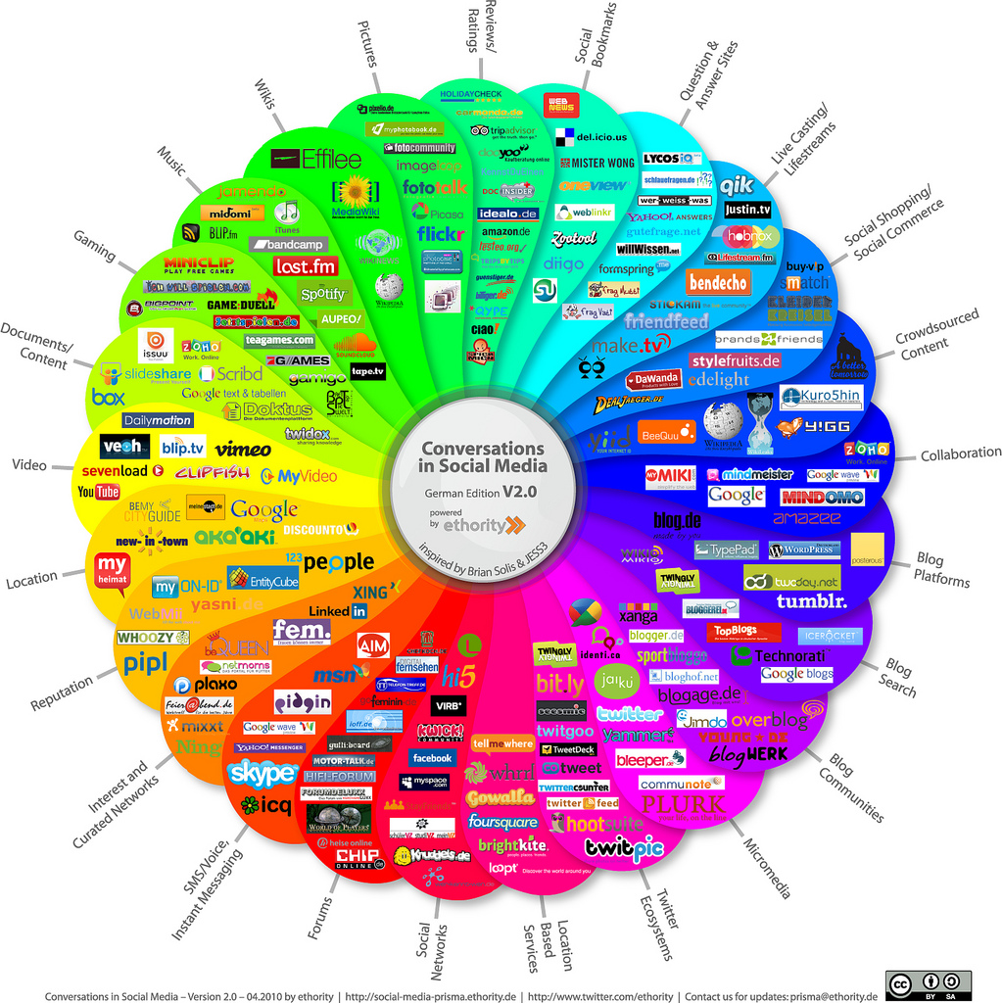

Slide 3
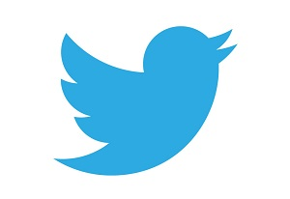
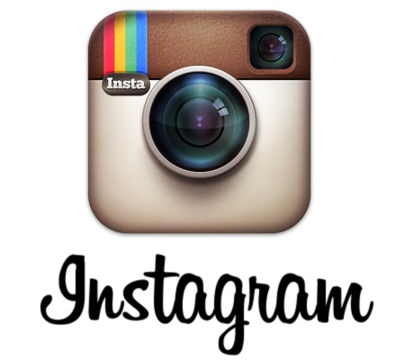

Slide 4
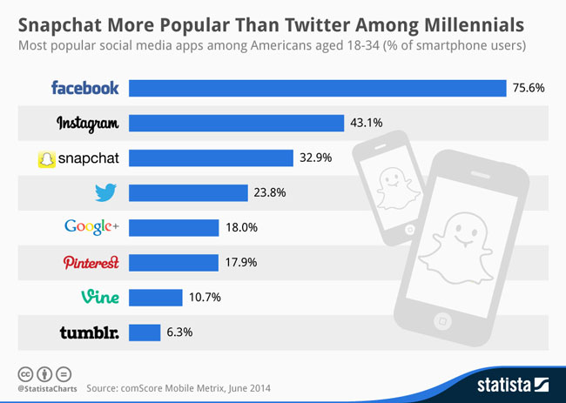

Slide 5
Finding a Way Through Social Media
Lots of people are “doing” social media marketing
Seek an efficient and effective path
Avoid random direction approaches
Apply a decisive strategy for success

Slide 6
The Seven Myths of Social Media Marketing
Social Media is Just a Fad
Social Media is Just for the Young
There is No Return in Social Media Marketing
Social Media Marketing isn’t Right for This Business
Social Media Marketing is New
Social Media Marketing is Too Time-Consuming
Social Media is Free

Slide 7
Why Social Media Marketing is Different
Traditional Approach
Controls content seen by audience
One-way communication
Domineering approach
Social Media Approach
Emphasizes audience contribution
Two-way communication
Discussion approach

Slide 8
Setting Goals
Define the desired outcome such as:
brand building
increasing customer satisfaction
driving word-of-mouth recommendations
producing new product ideas
generating leads
handling crisis-reputation management, or
integrating social media marketing with public relations and advertising

Slide 9
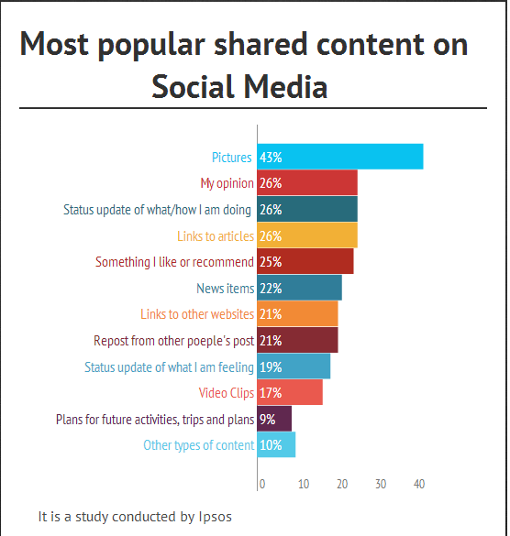

Slide 10
Instagram
Facebook Event Page
Timed Posts

Slide 11
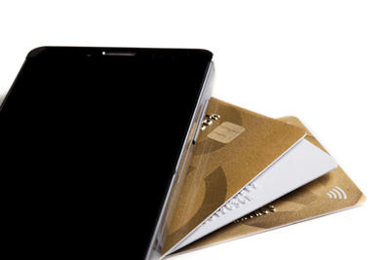
#1: Instagram Users Are Shoppers
Users were sharing product photos with friends, making comments, liking and getting opinions.
Unlike Facebook users who report that their primary reason for using that channel is to connect with friends and family, Instagram users may have more of a shopping drive.
70% of the 16,000 users in Iconosquare’s 2015 study reported that they have already looked for a brand on Instagram.
62% of users follow the brand simply because they “love” the brand. Forty-one percent follow or would follow to take advantage of perks and giveaways.
65% of Instagram users report that they feel flattered when a brand likes their post.

Slide 12
#2: Instagram Audience More Likely to Engage
Counting likes, shares and “re-grams” (like retweets) helps marketers investigate which of their efforts resonate with their target audience. All of these actions taken by targets are called “engagement” collectively.
According to a November 2014 Instagram study from research firm L2, users interacted 18 times more on Instagram than Facebook.

Slide 13
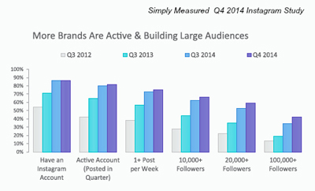
Simply Measured

Slide 14
#3: Instagram Audience Is Young
a September 2014 study conducted by AVG, cited in eMarketer, found that 44% of 18- to 29-year-olds and 62% of 11- to 16-year-olds had used Instagram in the previous month.
In comparison, only 18% of Baby Boomers (ages 45 to 60) and 10% of those 60 and older used Instagram in the past month.

Slide 15
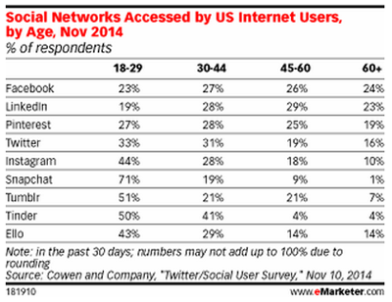

Slide 16
Tips
Facebook Event Page
Timed Posts
https://www.facebook.com/PennStateDuBois

Slide 17
Short tips for each platform
Facebook
Instagram
Do they have a good cover photo? (not too busy, nice design, well-branded)
Do they have a complete About Section with website listed?
Are they posting 1x per day at minimum?
Are they posting helpful content?
Ninja tip – add some funny content
Do they have Spam or unanswered posts?
Variety of content – images, links, videos, promotional content (Slide 10)
Posting photos of people?
Sharing same photo to Instagram and Twitter?
Including multiple hashtags on posts?
Following influencers within your sector or industry?
Variety of photos and content?
Nomenclature
Are you using online and offline strategies?

Slide 18
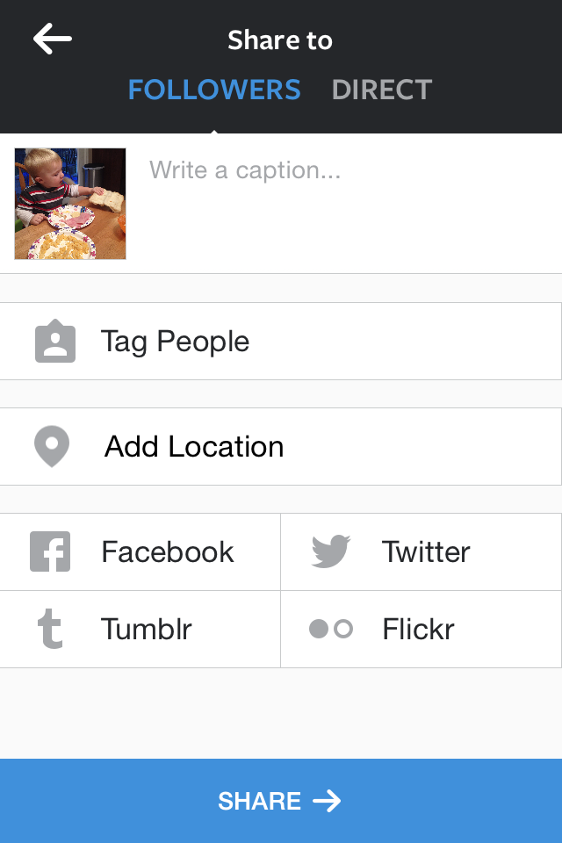

Slide 19
Calendar

Slide 20
Non profit services
www.ineedmagnus.com/freekit
Matt Checchio
Linkedin.com/mattchecchio
814.299.7041
mmc229@gmail.com

