Slide 1

For Real Estate
what it is, the 3 for 1, and how you can promote your business

Slide 2
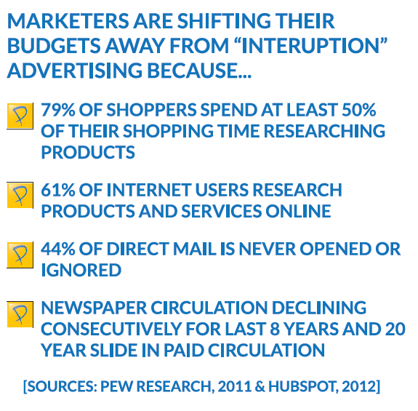

Slide 3
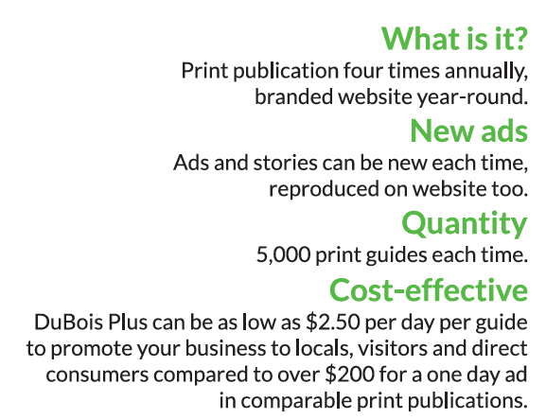

What is DuBois Plus?
print, website & facebook!

Slide 4
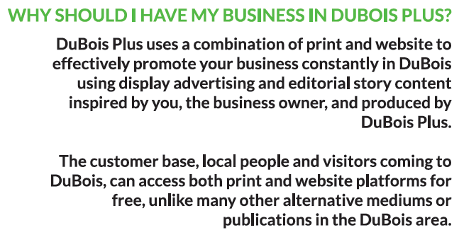

Slide 5


Slide 6

You pay one price to be in the…
1. DuBois Plus Print Guide:
  four editions per year – fall, winter, spring and summer
2. DuBois Plus website, duboisplus.com
3. DuBois Plus facebook page
  you are featured multiple times on the page

Slide 7

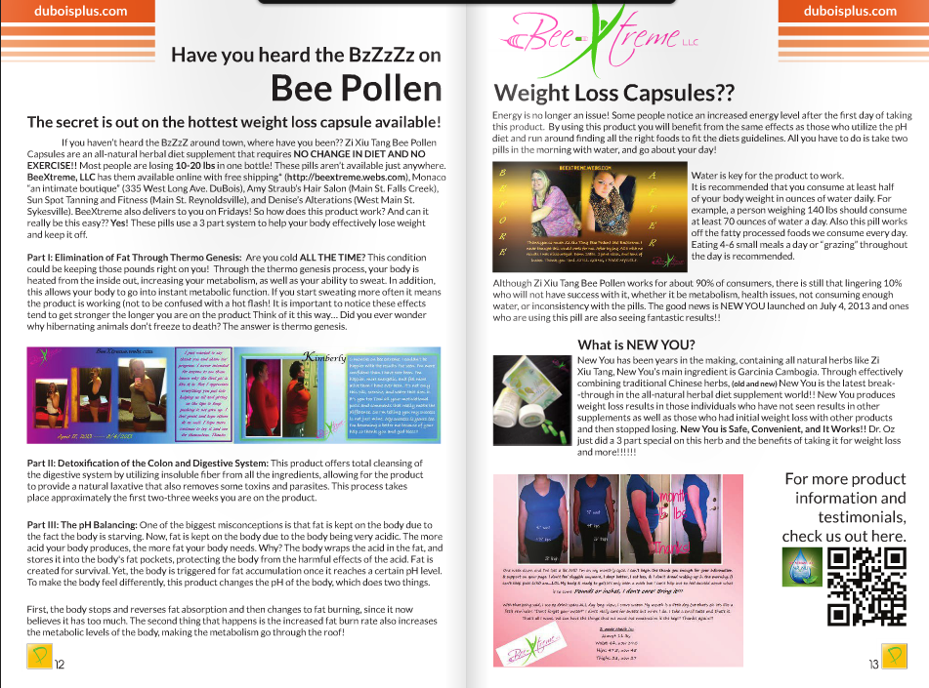

The Print Guide
5,000 print guides distributed
to over 120 locations in the tri-county area
restaurants, hotels, shopping, the mall, and local businesses
same ad and story content on the website –
no extra advertising sold on the website!

Slide 8
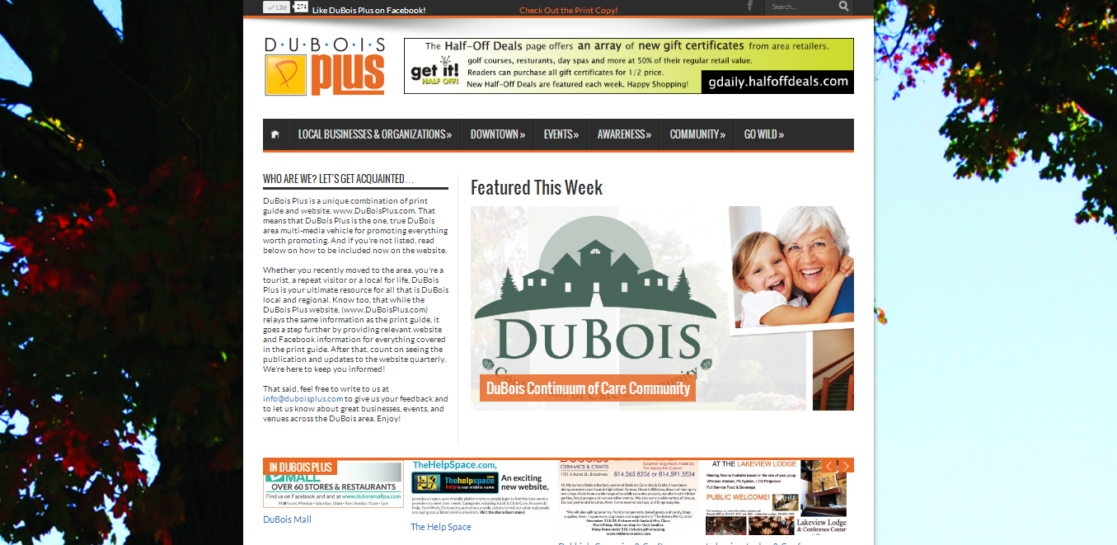
The website
duboisplus.com
your own webpage with your advertisement and story content
we rotate each business on the front page weekly
website built to get high search engine results when people search on Google or Bing for businesses like yours

Slide 9
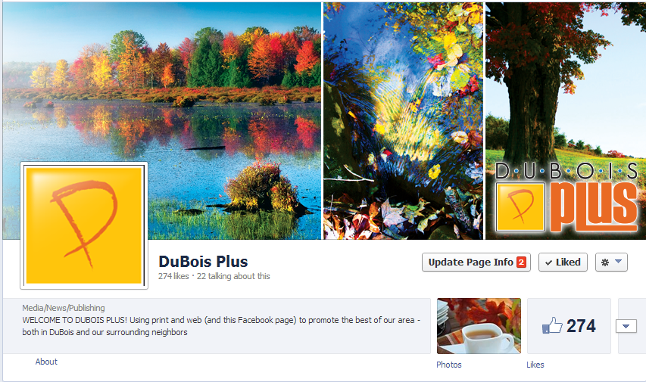

Facebook page
facebook.com/duboisplus
each business featured multiple times each edition on our wall
capitalize on the tens of thousands of locals communicating about local events, businesses and spreading word of mouth – this is the new form of referrals!
THERE IS NO OTHER 3 FOR 1 ADVERTISING & PROMOTION PROGRAM LIKE THIS IN OUR AREA!

Slide 10
Ideas on how to use for Real Estate
Utilize email marketing to increase your subscribers so that you can gain additional contacts
Highlight your well distinguished agents and the professional and pleasant experience they will offer to clients
Promote your other services or features such as residential and commercial sales, investment properties, college housing and leasing
Use the display ad to advertise your newest listings
Promote your well-known company name and award winning customer service
Include your website in the advertorial so that when someone is interested, they will be directed to your website

Slide 11
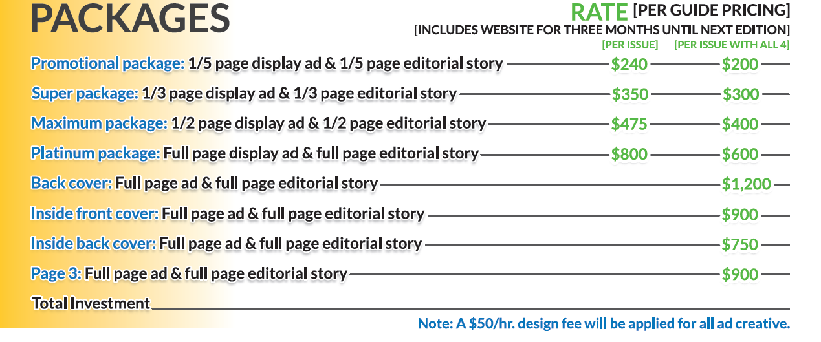
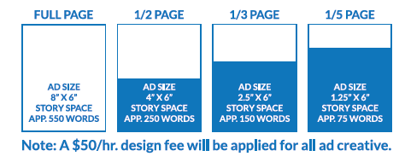
It’s affordable for every business…

Slide 12

Perfect time to promote holiday shopping and your season specials!!!
Design fee applies only to graphic design, not the story writing. If advertisement file is submitted to us, no fee applied unless it’s a re-design.
Becca rebecca@duboisplus.com
Izen izen@duboisplus.com
Tony tony@duboisplus.com
Contact us
right away!

