Slide 1
For Professional Services
what it is, the 3 for 1, and how you can promote your business

Slide 2
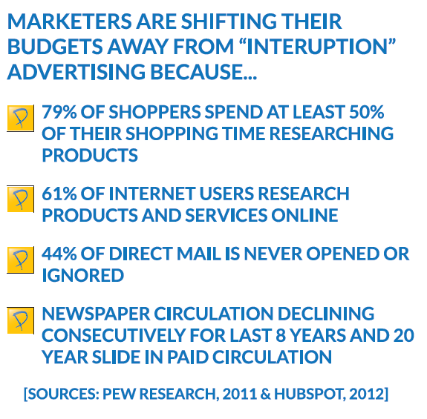

Slide 3
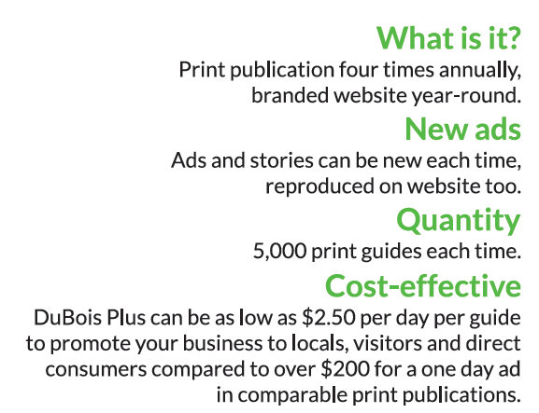
What is DuBois Plus?
print, website & facebook!

Slide 4
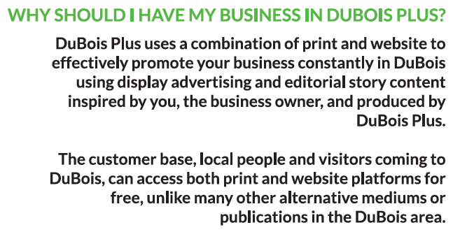

Slide 6
You pay one price to be in the…
1. DuBois Plus Print Guide:
four editions per year – fall, winter, spring and summer
2. DuBois Plus website, duboisplus.com
3. DuBois Plus facebook page
you are featured multiple times on the page

Slide 7
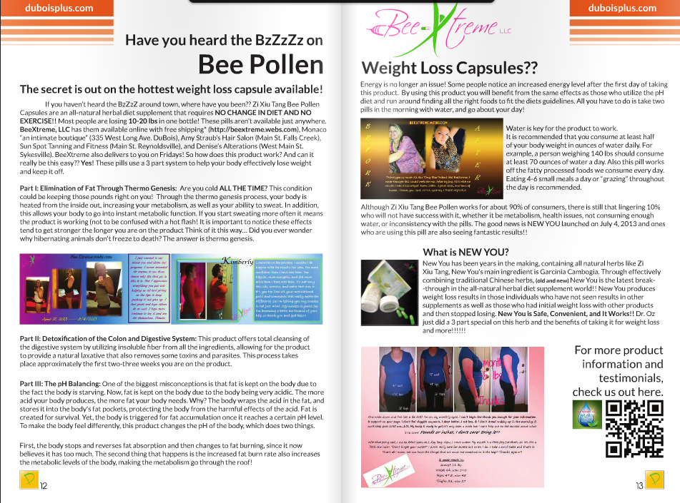
The Print Guide
5,000 print guides distributed
to over 120 locations in the tri-county area
restaurants, hotels, shopping, the mall, and local businesses
same ad and story content on the website –
no extra advertising sold on the website!

Slide 8
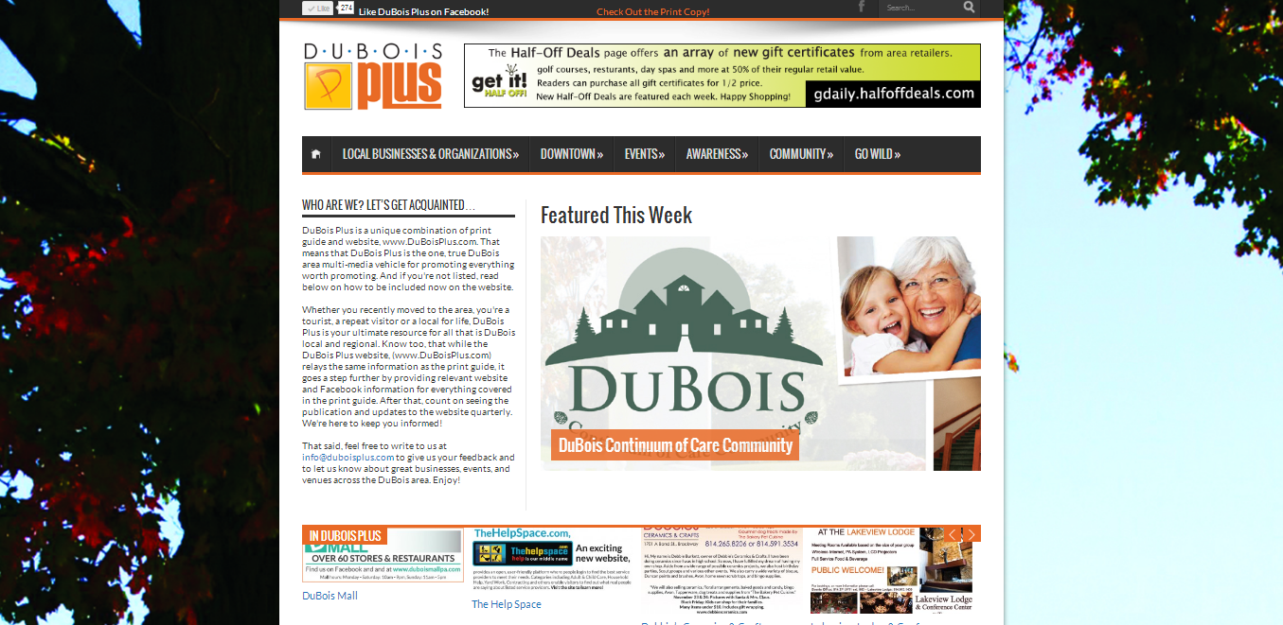
The website
duboisplus.com
your own webpage with your advertisement and story content
we rotate each business on the front page weekly
website built to get high search engine results when people search on Google or Bing for businesses like yours

Slide 9
Facebook page
facebook.com/duboisplus
each business featured multiple times each edition on our wall
capitalize on the tens of thousands of locals communicating about local events, businesses and spreading word of mouth – this is the new form of referrals!
THERE IS NO OTHER 3 FOR 1 ADVERTISING & PROMOTION PROGRAM LIKE THIS IN OUR AREA!

Slide 10
Ideas on how to use for Professional Services
Use the story to highlight the various services you offer
Make customers aware of your trustworthy service at a reasonable cost
Promote your other features such as certified technicians, timely scheduling
Use the advertisement part to promote seasonal projects (for example, lawn care, building a patio)
Promote your expert employees and top-notch customer service
Increase awareness of your company's existence

Slide 11
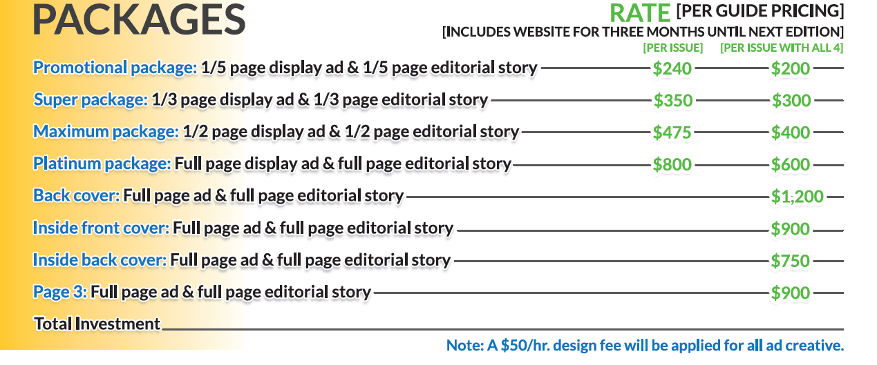
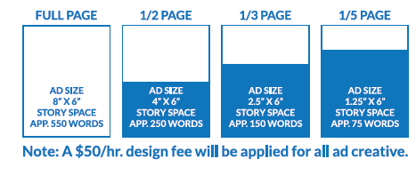
It’s affordable for every business…

Slide 12
Perfect time to promote holiday shopping and your season specials!!!
Design fee applies only to graphic design, not the story writing. If advertisement file is submitted to us, no fee applied unless it’s a re-design.
Becca rebecca@duboisplus.com
Izen izen@duboisplus.com
Tony tony@duboisplus.com
Contact us
right away!

