Slide 1
Barber Trucking
Strategic Marketing Plan for Driver Recruiting
February 2015

Slide 2
Background
Background synopsis
Competitors
Driver demographic overview
Current Driver Survey

Slide 3
Objective and goals
Increase total drivers to 100
75 / 25 company drivers to owner-operators
In December, about 62 drivers
Implement a direct marketing strategy
Build an overall strategic marketing plan, that includes both drivers and community awareness
Metrics to gauge effectiveness and successes

Slide 4
Why is there a shortage of drivers?
There are many reasons for the nation wide storage of truck drivers. The average age of a truck driver in the US is 55 years old according to t he Bureau of Labor Statistics. Driving truck isn’t a “dream job” it’s extremely hard work and being away from family and friends isn’t a life for everyone. Most of the younger workers are opting for construction, mining, and other skilled labor jobs where they are home more and have an increase in pay.
The biggest issue with keeping truck drives is the smaller wages. In 2013 the average U.S. tractor-trailer drivers annual wage was $40,940, 11.8% below the U.S. national average yearly wage of $46,440 according to the U.S. Bureau of Labor Statistics. Trucking wages have increased much more slowly than the rest of the U.S. salary, steering people away from the industry.
Another problem companies are dealing with is the turnover of drivers. Many carriers may go through 3-4 new drives to obtain one that sticks with the company. The turnover rate is lower for small fleets then the big carries at 82% compared to 92%. The high turnover rate is in part to drivers getting their feet wet in the industry and then some move on when they are highly recruited by others. These are some of the major problems the industry is facing as a whole over the last few years in trying to acquire more/new drives and keep them in their company.

Slide 5
Positioning and Branding to address from Research
Business Insider
“Driver retention is now key” – we’ve included a Retention outline for a plan
“If you keep a driver for 90 days, the [turnover rate] generally drops in half [to 45%]. - retention outline
“Drivers are jumping from carrier to carrier with no great new influx”- outdoor marketing along routes
“Drivers want to make more money and they want more home time” – Barber positioning and messaging
Supply Chain Digest
“Turnover lower at smaller carriers; due to family atmosphere”
“Drivers get their feet wet in the industry and then some move on when they are highly recruited by others” – Segments picked
CNN: driver shortage
“Some are opting for higher paying jobs in construction and shale oil”
“All of trucking: poor working conditions, over-worked, underpaid, high health and safety risks” –Barber benefits and selling points to address on micro-website for recruiting new drivers

Slide 6
Positioning and Branding to address from Research
AJC: demand is high
Content for marketing/micro-site
“Trucking added the most jobs of any transportation sector in 2013; demand expected to grow by 21% through 2020”
“Truck driving one of the few careers can train quickly and earn $40-50k”
“By year 3, should be making into $50,000s”
“Newer segments in CDL classes: career changers, retirees, former military people and business owners wanting to start a second career. Women : safety-conscious and well-organized.” Segments to target.
“Self-starter, able to work with no supervision, home on weekends” – survey
“Working conditions have improved, trucks more comfortable and equipped”
NY Times
“Some drivers could be coaxed back into the industry if the money were right”- target CDL holders, and former Barber drivers.

Slide 7
Positioning and Branding to address from Research
CNBC: Inside the shortage
Preferred industry among 18-24 year olds beginning their careers:
1. Technology : modern trucks feature technology
2. Energy
“Fewer guys want to do long-hauls; younger drivers prefer regional jobs and family life” – Barber selling points for shorter regional hauls, home on weekends
“Certain amount of independence; enjoy using hands, tying down loads, don’t have a boss right behind them” – all more selling points in Content

Slide 8
Competitive Analysis: other trucking companies
Western Express
CRST
Schneider
McCauley Trucking- from brookville (50 trucks)
Swift
Landstar
TMC

Slide 9
Competitive Analysis (cont)
Bradigan’s
Heard on the radio (Froggy)
http://www.bradigans.com/index.cfm?NavID=55
DiLullo Trucking in DuBois, PA
3 trucks

Slide 10
Current driver look
New York
Average Age 45.7
Average Years of Service: 2.645
Average YTD wages: $25,265
NY +1 Years of Service
Average Age 47
Average Years of Service: 3.07
Average YTD wages: $37,360

Slide 11
Current driver look
Pennsylvania
Average Age 44.167
Average Years of Service: 5.67
Average YTD wages: $44,489
PA +1 Years of Service
Average Age 44.9
Average Years of Service: 5.67
Average YTD wages: $49,064

Slide 12
Current driver look
North Carolina
Average Age 40.55
Average Years of Service: 2.37
Average YTD wages: $29,870
NC +1 Years of Service
Average Age 44.28
Average Years of Service: 2.998
Average YTD wages: $37,890

Slide 13
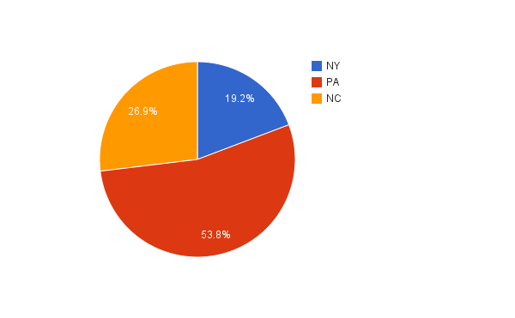
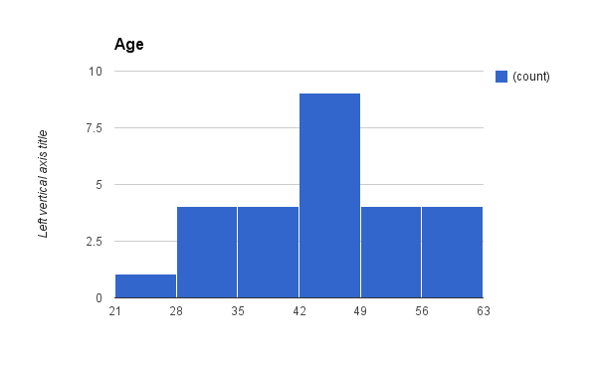
Current driver survey
26 respondents

Slide 14
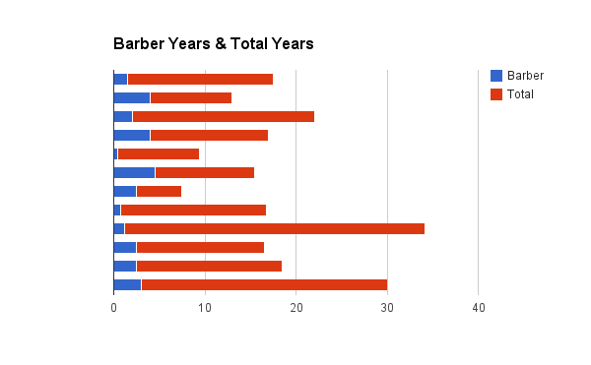
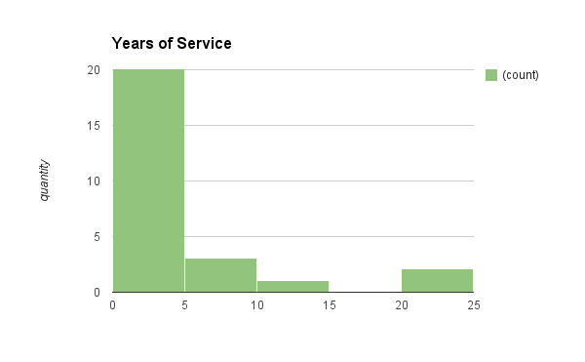
Current driver survey
26 respondents

Slide 15
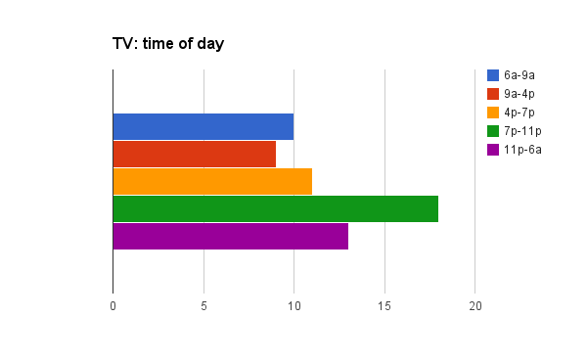
Current driver survey
Media usage
Internet is overwhelmingly #1 to get news/info
Radio and newspaper scored low consistently
TV: weekends/Saturdays (all) or 11p-6a (NC)
1: Fox, 2: NBC, but all those who chose NBC as 1, had Fox as second choice.
Cable: Discovery, A&E, History and Weather Channel

Slide 16
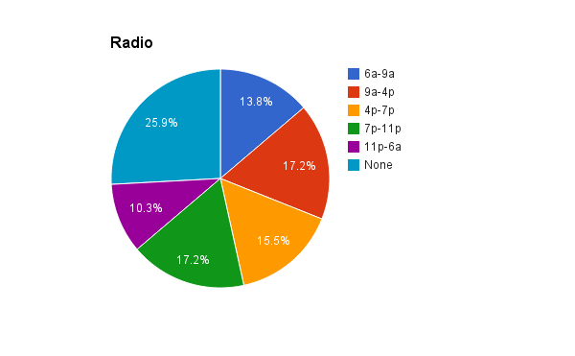
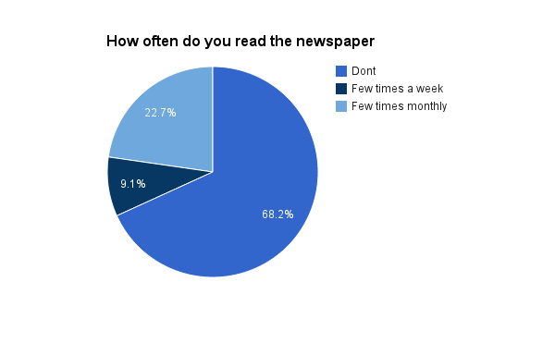
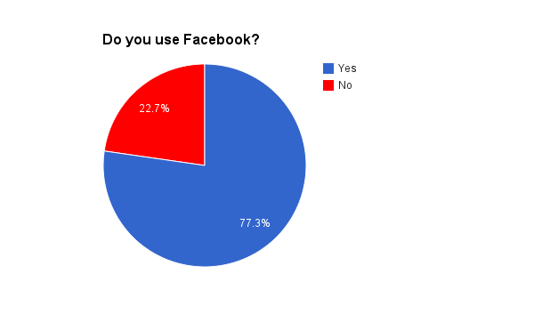
Current driver survey

Slide 17
Current driver survey

Slide 18
Current driver survey

Slide 19
Current driver survey

Slide 20
Current driver survey

Slide 21
Brand positioning
Target mindset
Positioning
Key Supporting Messages
Communication Guidelines

Slide 22
Target Mindset: “Independent Earners”
Barber Trucking drivers are independent workers who understand their role in moving the country. They attack each job in a blitz campaign, because they know that their work affords them the things they value most in life, deserved and earned: time home with family and friends, financial independence, and promotion from within a company who sees them as more than just a number.

Slide 23
Positioning and Branding
We are focusing on new Barber Trucking drivers who are independent workers with 2+ years experience that take instruction and take on responsibility. They thrive in an environment where they have the power the set their own pace. They prioritize their home time, time on the road, financial earnings, and their ultimately their career in the way that works best for them as an individual and primary family provider. That’s why military members and prior service members are ideal candidates for the job.

Slide 24
Key Supporting Messages
Barber Trucking recognizes what each employee does to contribute to the team, and will reward those who are loyal and committed to safety.
Barber Trucking doesn’t focus only on delivered hulls and mileage. It’s a place where every employee can feel valued as an individual who has goals and priorities outside of the workplace.
Barber trucking understands that employees have put in the effort and energy to earn their time off and advancement through the company.
Barber Trucking provides a much needed service throughout the North East. Without truck drivers, costs would skyrocket, and people would have to do without.

Slide 25
Communication Guidelines
Ensure communications use key supporting messages and are brand focused.
Stress the Barber Trucking differentiating factors with emotive visuals and stories from current driver.
Celebrate the team of drivers both internally and externally.
Reflect the mission and values of Barber Trucking at all times.

Slide 26
Brand messaging
Slogan and mantra
Segments to target

Slide 27
Driving for YOU
Family (great pay, weekly pay, home weekends)
Financial stability (unlimited earning potential, bonuses, pay raises, promotion into corporate office or HUB)
Independence (outdoor, hands on, no boss)
Job security (27+, “keep the economy moving”, niche clients with specialty hauls)

Slide 28
Barber Trucking…Driving for YOU
You’re not driving for Barber, you’re driving for YOU.
You’re driving for your family.
You’re driving for your weekends at home.
You’re driving for your financial future.
You’re driving for your unlimited earning potential.
You’re driving for your independence.
You’re driving for a great job that’s hands on and never the same day.
You’re driving for your created job security.
You’re driving for those clients depending on your ability.
You’re driving because you keep the national economy moving.

Slide 29
Truck Driver Stats: National Truck Driving Jobs
One of every 15 people in the US are employed by a trucking company
Of Truck Drivers in the U.S.
58% are White Males
18.7% are Hispanic Males
16.6% are “Other” Males
6.7% are Female
Age
21-24: 2%
25-29: 7.9%
30-34: 11.6%
35-44: 30.2%
45-54: 27.2%
55-64: 17.3%
Top 5 states: TX (145k), CA (123k), PA (71k), FL (65k), Ohio (65k)

Slide 30
Three trucker segments focus on:
2+ years experience
21-24 months ideally to target
Target company drivers at bigger companies
CDL new graduates
Build loyalty to Barber from start
Non-CDL holders
ATRI: federal requirement that interstate CDL holders be 21 or older resulting in 3-year post high school gap- can Barber hire them for other jobs?
Pre-driver jobs>>>Driver>>>Post-jobs (career advancement)
Retention strategy…

Slide 31
Audience segment groups to target:
Veterans
Paying for CDL exam
3 months/12 trips driving for Barber, exam fee is reimbursed
Young drivers 25-34 (graph next slide)
Married and/or families 25-44
White & black male 25-34, no college
“Needs to attract workers in their late 20s and early 30s from other occupations where they have reached their earnings potential” (ATRI, 2014).
Latino/Mexican
Women

Slide 32
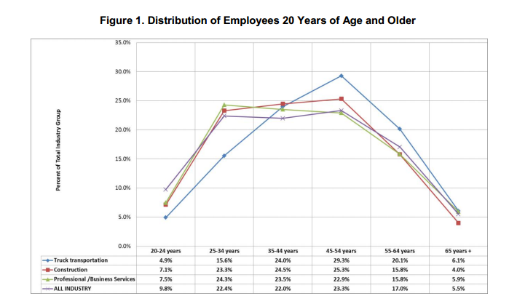

Slide 37
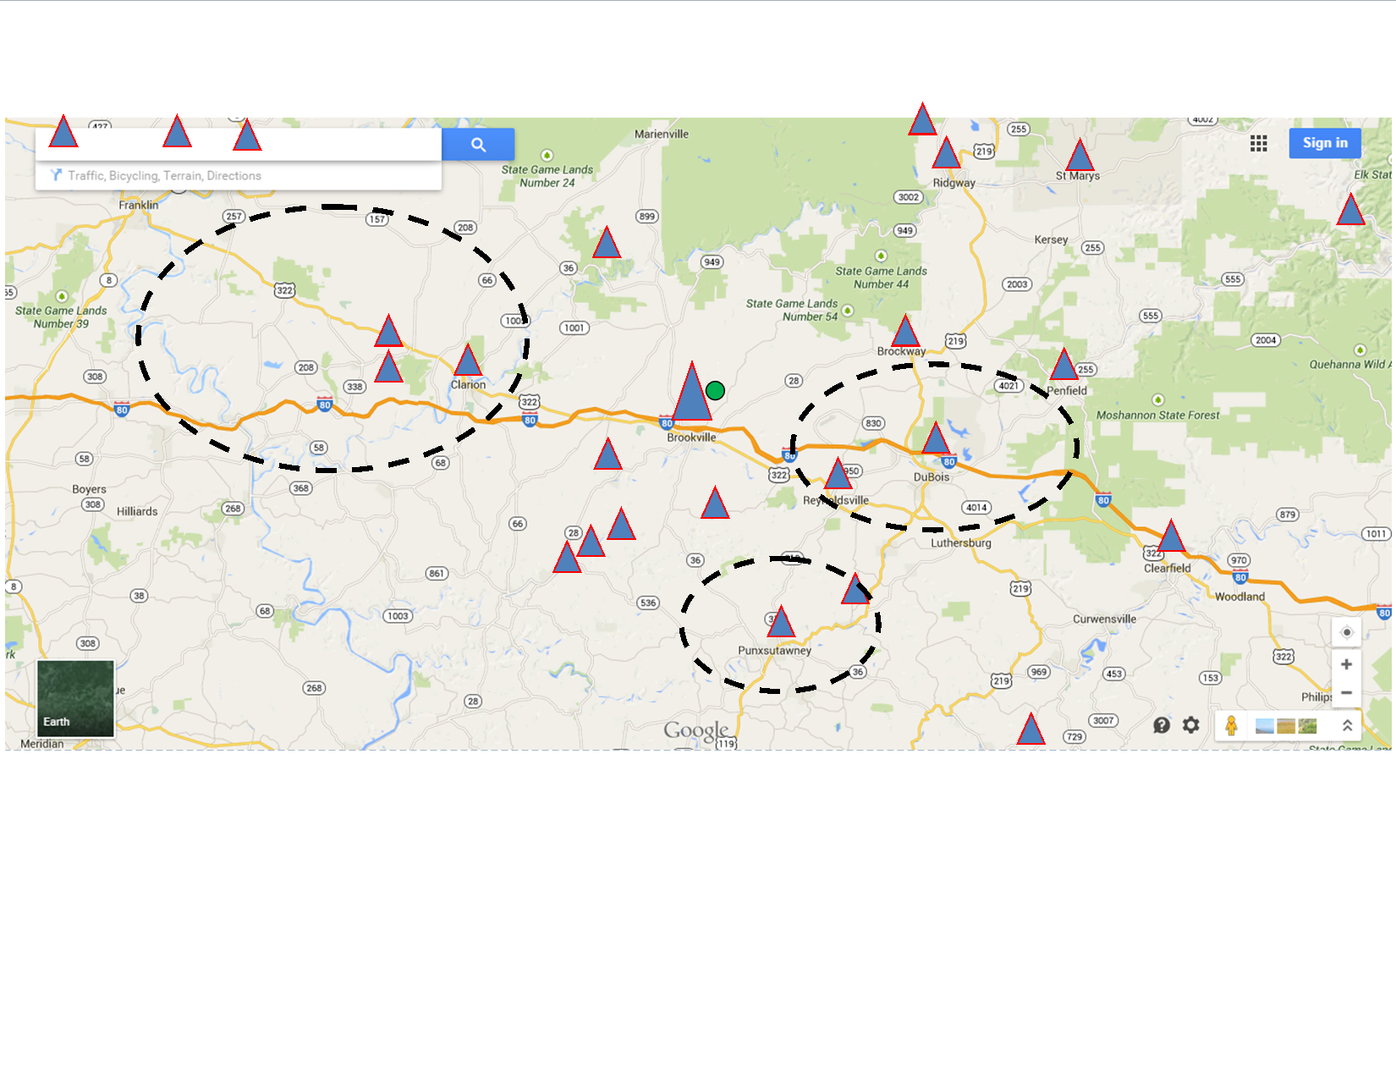
Three drivers from NW part of state are all hired within 4-7 months (of Nov 2014). Trend?
Pennsylvania
Over 1000 CDL holders in Northwest PA that we can target with direct marketing

Slide 38
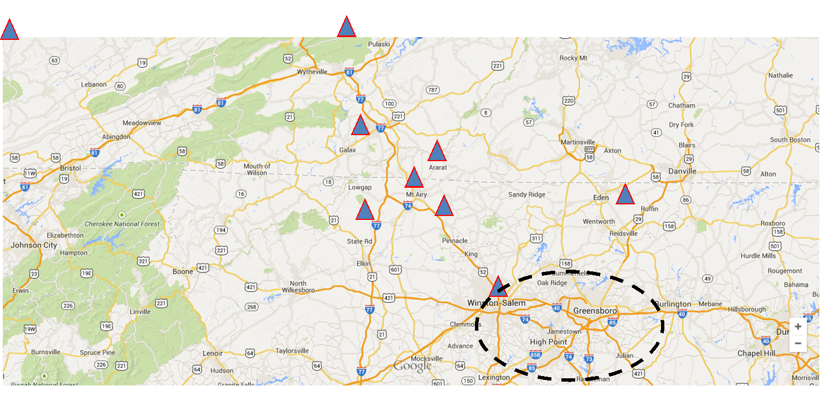
Over 2000 CDL holders in Greensboro, Winston-Salem area

Slide 39
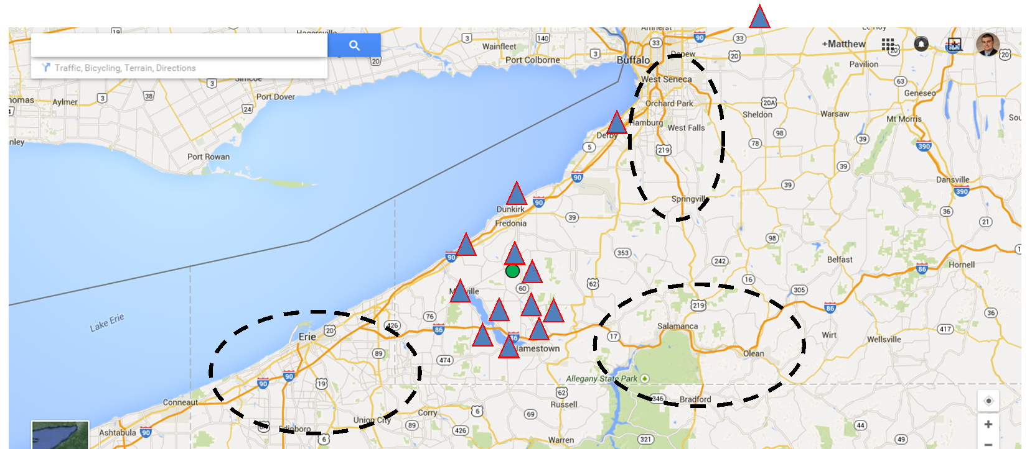
5 drivers out of 11 hired within 3-10 months in 2014
CDL A and B in Southwest NY – getting #

Slide 40
This is now the State of Barber… next slide
Southwest NY and Northwest PA

Slide 41
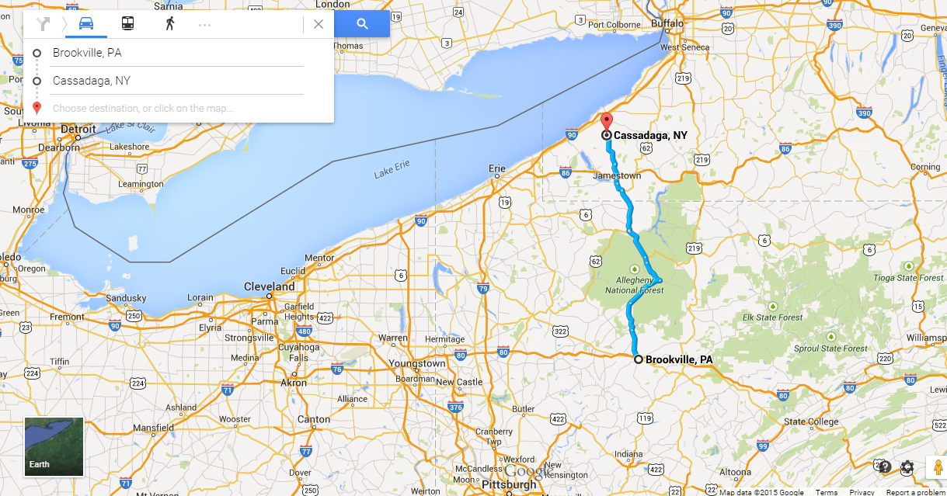
The State of Barber: southwest NY and Northwest PA
Eastern PA from Clearfield up north to Rt 390, continues to southern part of Buffalo metro, down I-90 to Erie, and southern border lines out from Corry to Indiana Pa.

Slide 42
Content marketing
Target mindset
Positioning
Key Supporting Messages
Communication Guidelines

Slide 43
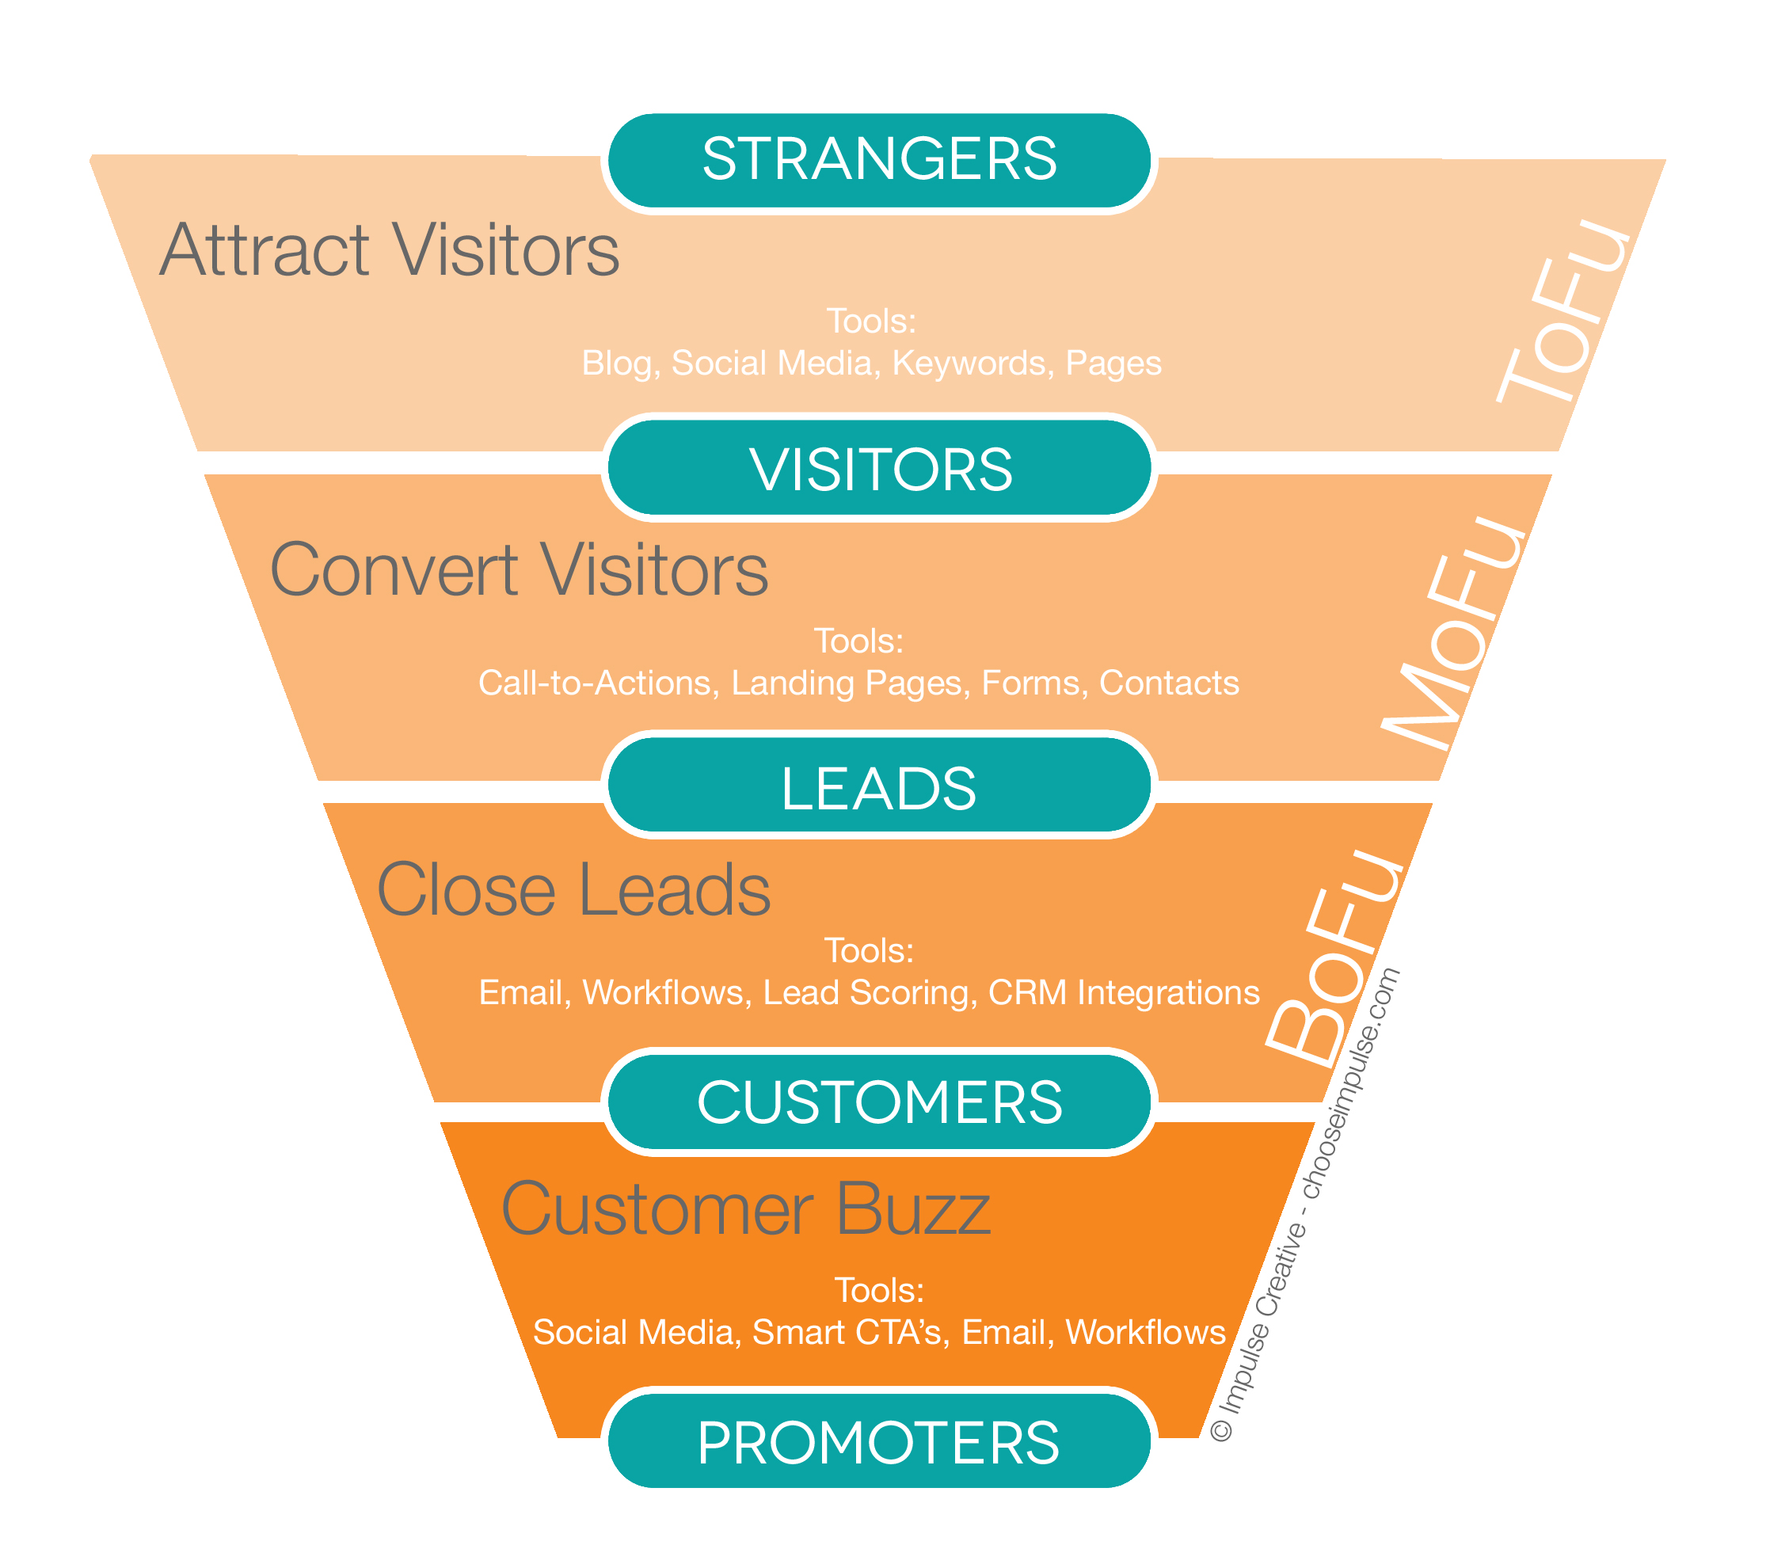
Internet Marketing Tree & Communications/Advertising
Micro-website
Contact form
Questionnaire
Application online
Direct Marketing

Slide 44
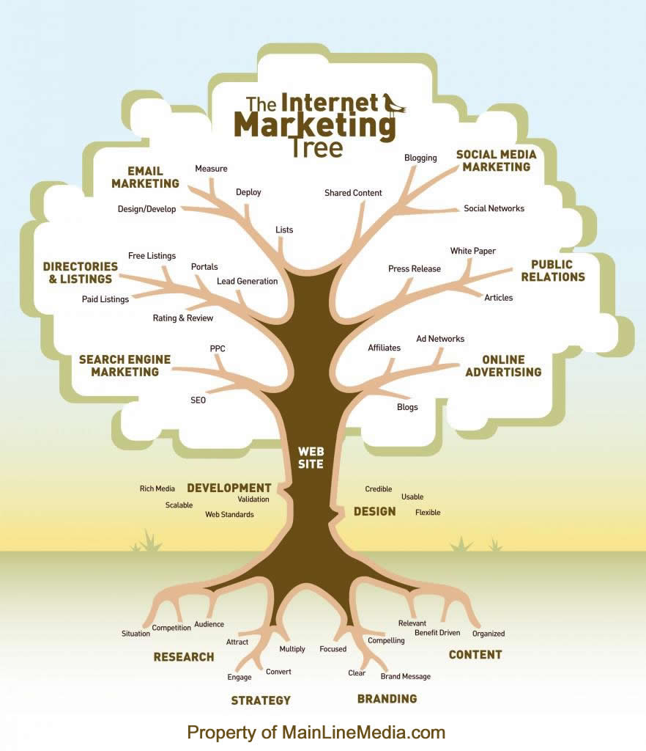

Slide 45
Micro site
Recruiting micro-website with content:
Branding points and slogan messaging
Specialty flat-bed hauls about the Company
Comparison to other trucking companies or industry negatives; counterpoints to how Barber does not fit those profiles or positively reinforces our selling points better
Benefits
Pay scale
Testimonials
Contact
Push to drive those interested to submit basic contact info but not a full application
Owner Operators
Separate landing page: specific info to them with contact form. SEO tags specific to their searches and internet usage.

Slide 46
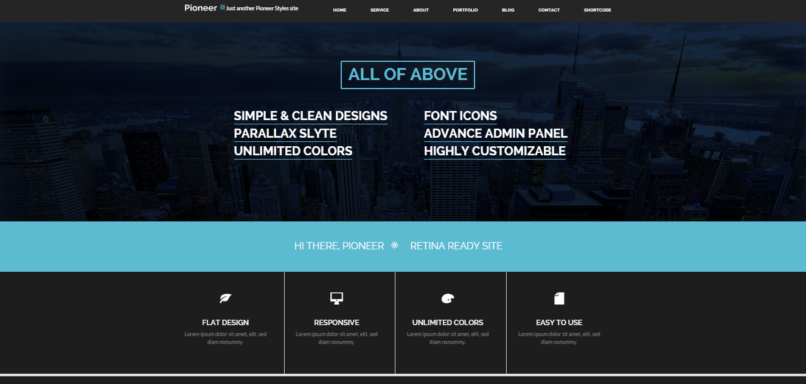

Slide 47
Contact card and questionnaire
Shorter Contact Card
Personal info, location, CD or OO
Questionnaire
Personal info, demographics, short driver info
Online application

Slide 48
Video content
Producing 1-2 minute long recruiting video to use on the microsite
Mind Over Media TMC video example

Slide 49
Current Memberships
Truckload Carrier Association (TCA)
National Association of Small Trucking Companies (NASTC)
Owner Operator Independent Drivers Association (OOIDA)
We do work with Careerlink and Workforce Investment Board (WIB) regionally.
Suggested:
Chautauqua County, NY (Cassadaga) $175 for 5 employees
Great Mt. Airy Chamber of Commerce

Slide 50
Marketing communications
Advertising
Direct Marketing
Promotional
Community Awareness, Events and Publicity

Slide 51
Advertising The outbound or push strategy to gain new inquiries

Slide 52
Communications and Advertising
Strategy:
1) Directly target potential drivers
2) Community and company awareness
Mediums to use:
Job & Trucking online third-party websites
Outdoor
Television
Social media advertising: Facebook
Magazines and publications
Online banner advertising
Keyword targeting
Retargeting
Newspaper
Radio

Slide 53
Job & Trucking News websites
Job websites
Not on these currently:
Monster $290 for 30 days
Indeed $.25-$1.50 per click
CareerBuilder
Every truck job
CDLhunter
National Truck Driving Jobs $150 month
Trucking news websites (publicity opportunities as well)
RoadKing
TruckingInfo
Transport Topics
Banner ad network
Everytruckjob.com
Bannersnack
facebook
Targeted Digital Media such as the magazine websites & job websites

Slide 54
Outdoor:
Trucks, Truck stops and other locations
Truck Branding
Pop up signage on flat bed sides
Mud flaps
Side hood
Magnets on truck door with phone number and microsite
Decal on the back of the truck with the slogan How often is that area covered/block? 25%? 50%? 99%?
Explore signage opportunities and guerilla marketing to use the shell creative
Pilot Flying J
Signage and advertising opportunities at locations
Road Warrior contest: $10,000 and publicity to one driver – Dan.

Slide 55
TV
NCIS
NCIS
NCIS…
Sons of Anarchy
Ice Road Truckers
Deadliest Catch
Pawn Stars
Family Guy
Chicago Fire
Chicago PD
Cops
Street Outlaws
Gold Rush
Creative and imagery for TV spot
Family
Financial and job security
independence
Focusing on cable television to target specific drivers, and also use survey information from current drivers:
Discovery
A&E
History
Weather Channel
Broadcast
Fox
NBC

Slide 56
Social Media
Facebook
about 80% of your current drivers use facebook already
Barber Trucking Page
Facebook Advertising
Twitter: down the road
#BlackandChrome
#SafetySunday
#FlatbedFriday
#ThrowbackThursday
#TruckerTuesdays
#BumpinFridays
#WheelinWednesdays
#HeadingHome

Slide 57
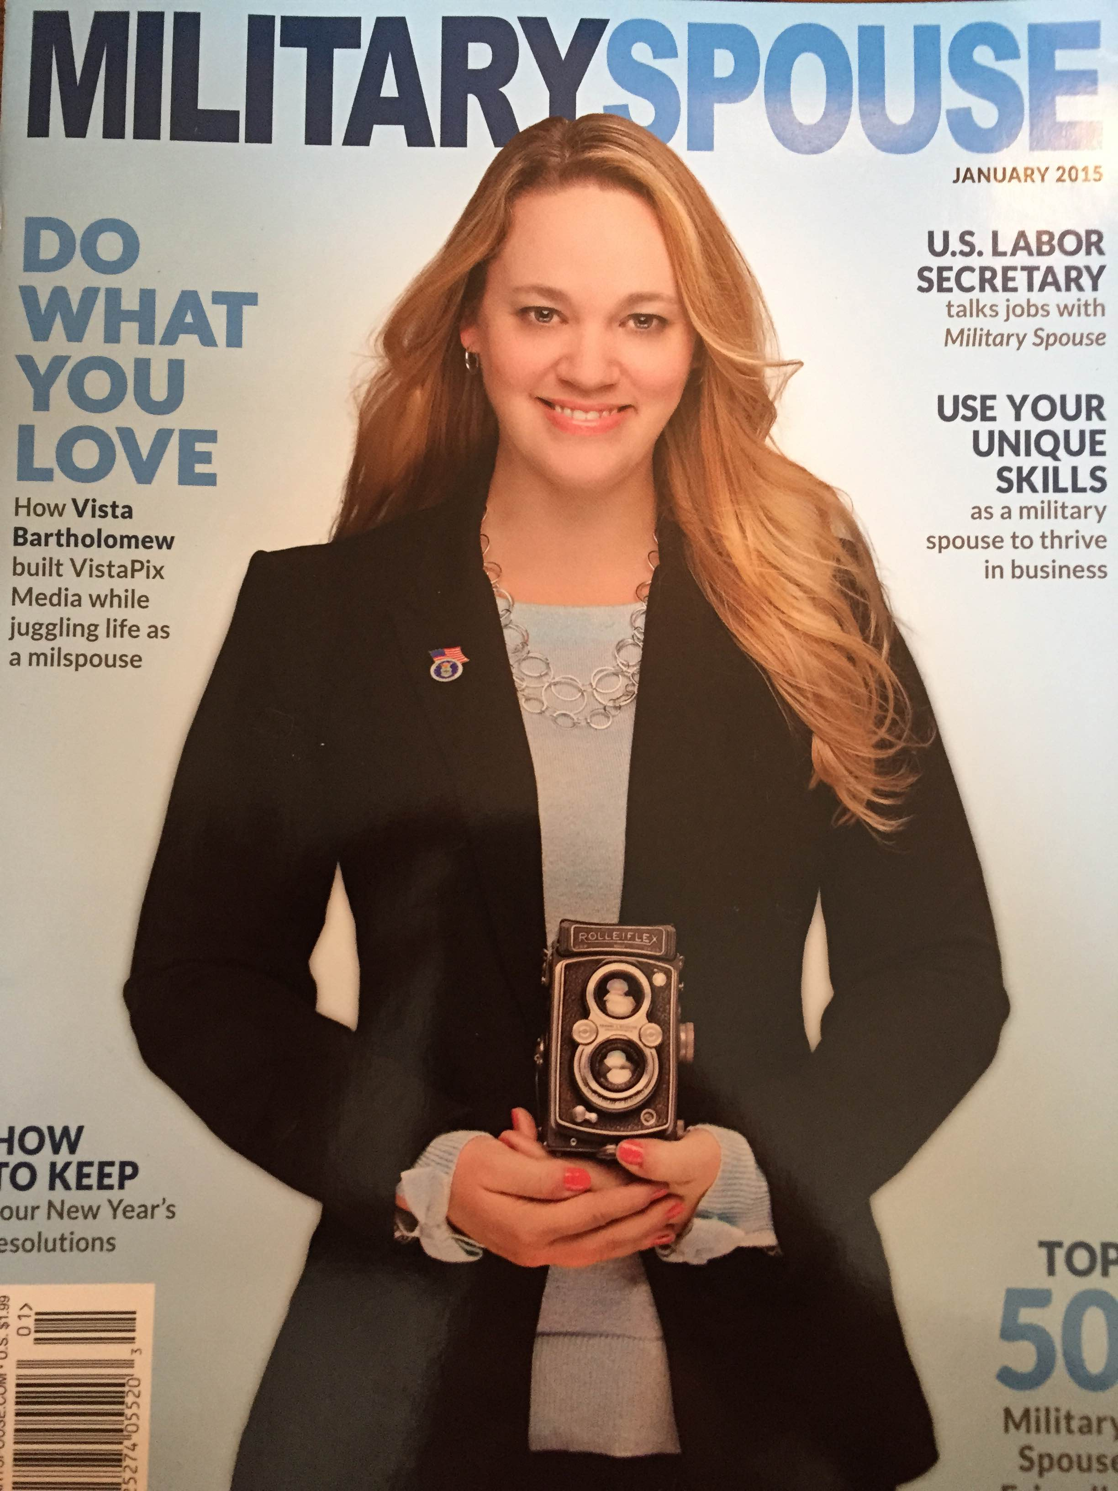
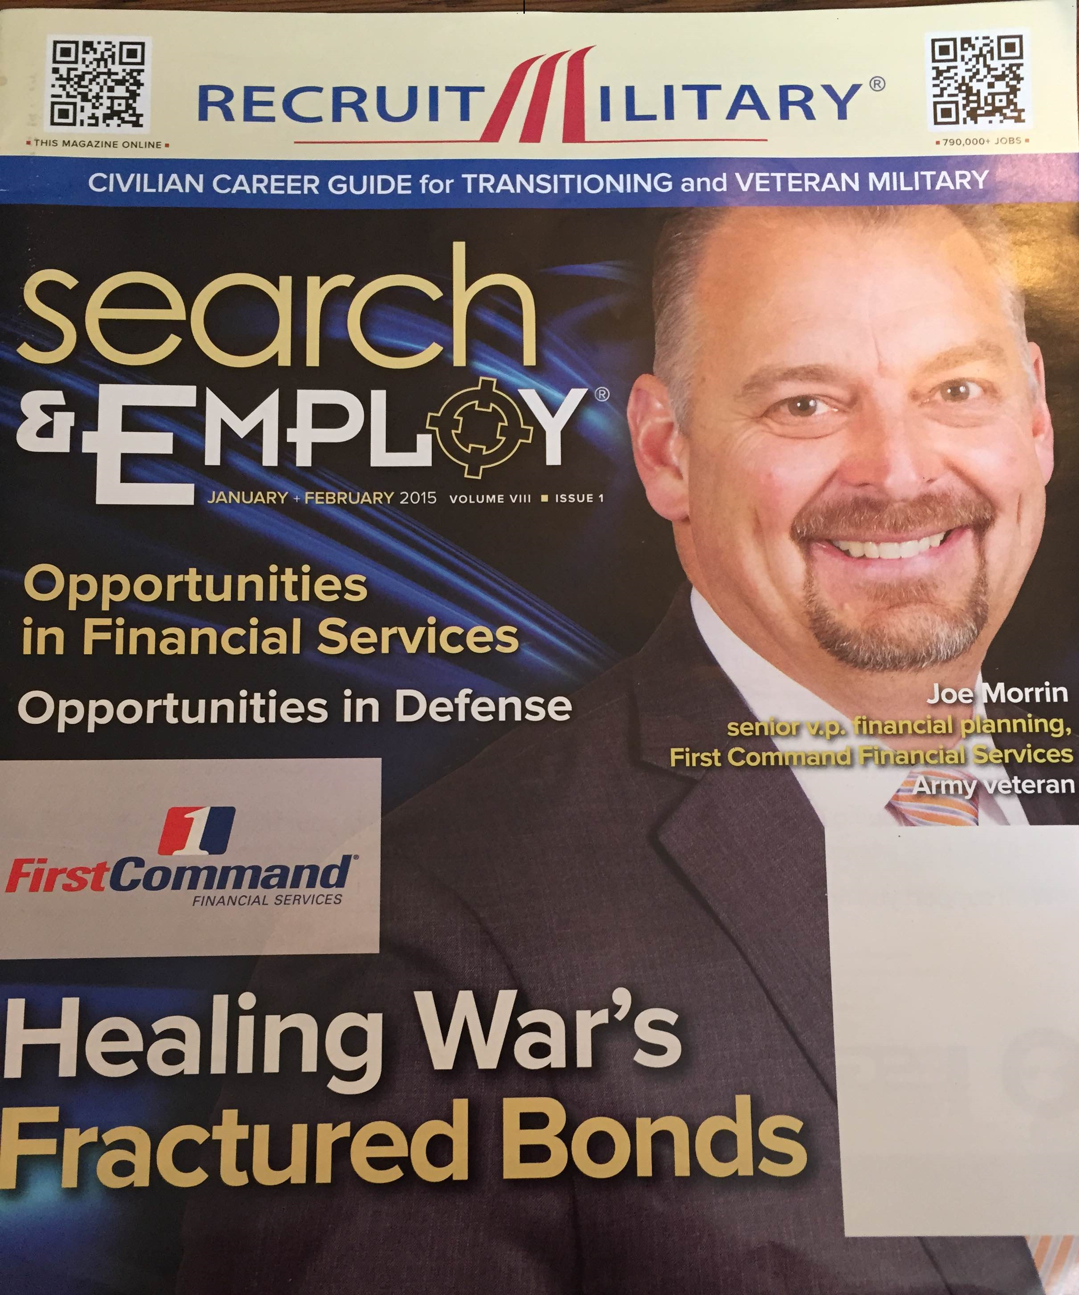
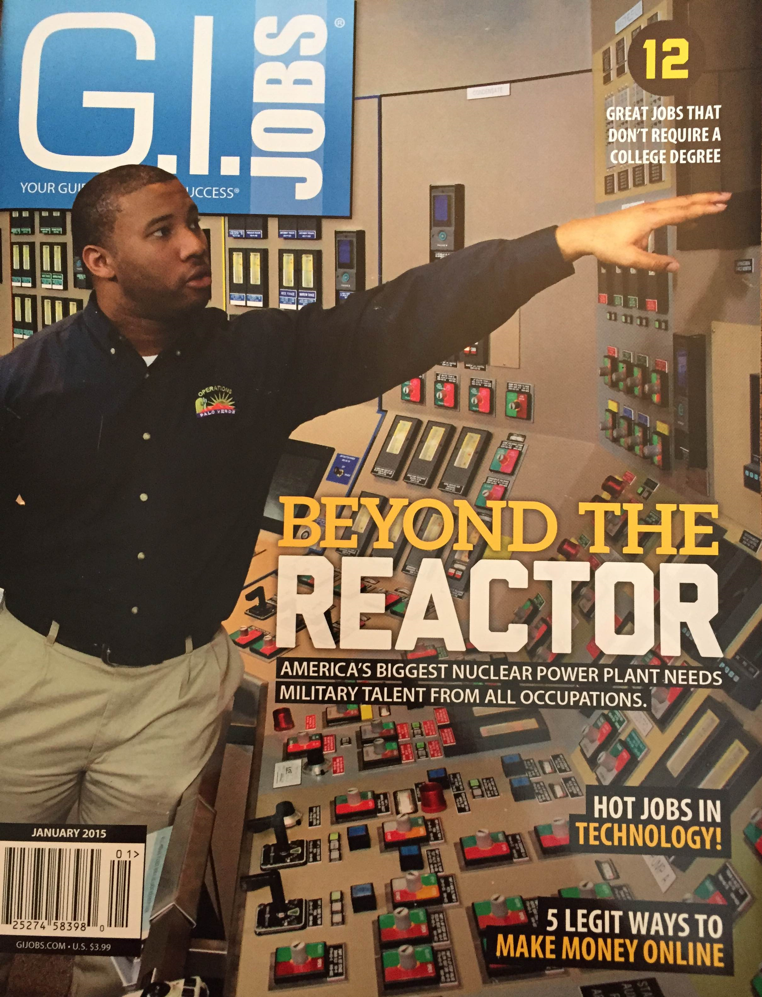
Magazines and publications
Magazines
Perfect fit for the Veteran segment
US Veterans Magazine http://www.usveteransmagazine.com/
American Veteran Magazine http://www.amvets.org/american-veteran-magazine/
Perfect fit for NC National Guard – The Hornet

Slide 58
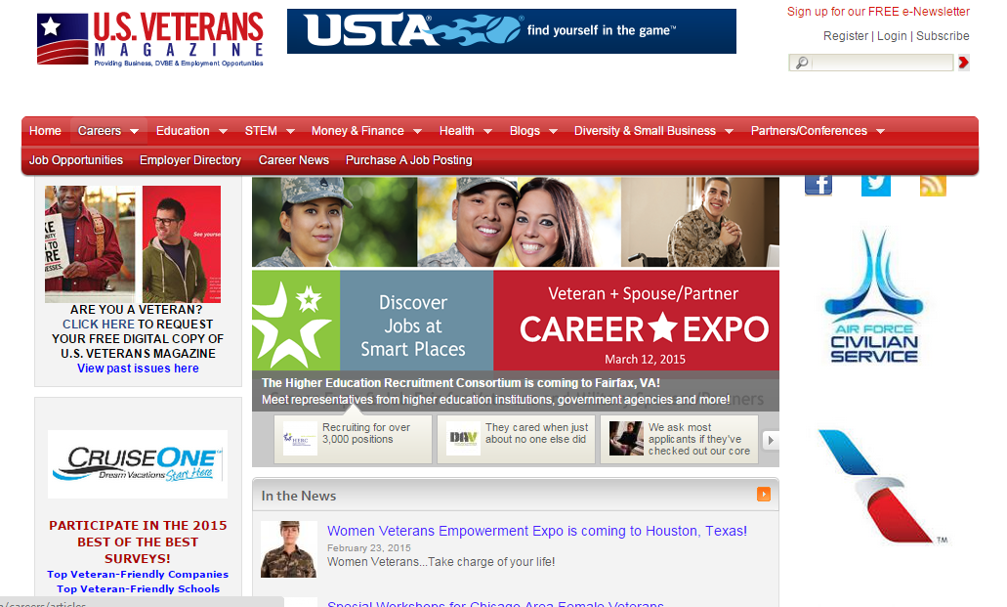

Slide 59
Direct marketing The inbound or pull strategy to gain new inquiries

Slide 60
All the content marketing being pushed out…
Content pushes and pulls drivers to Microsite…
Our original content on Barber Blog
Shared content from other blogs
Testimonials of current drivers
Video content
Driver of the month/Year
Social media content through plug-ins
Being shared on social media, e-mail marketing, third-party industry sites

Slide 61
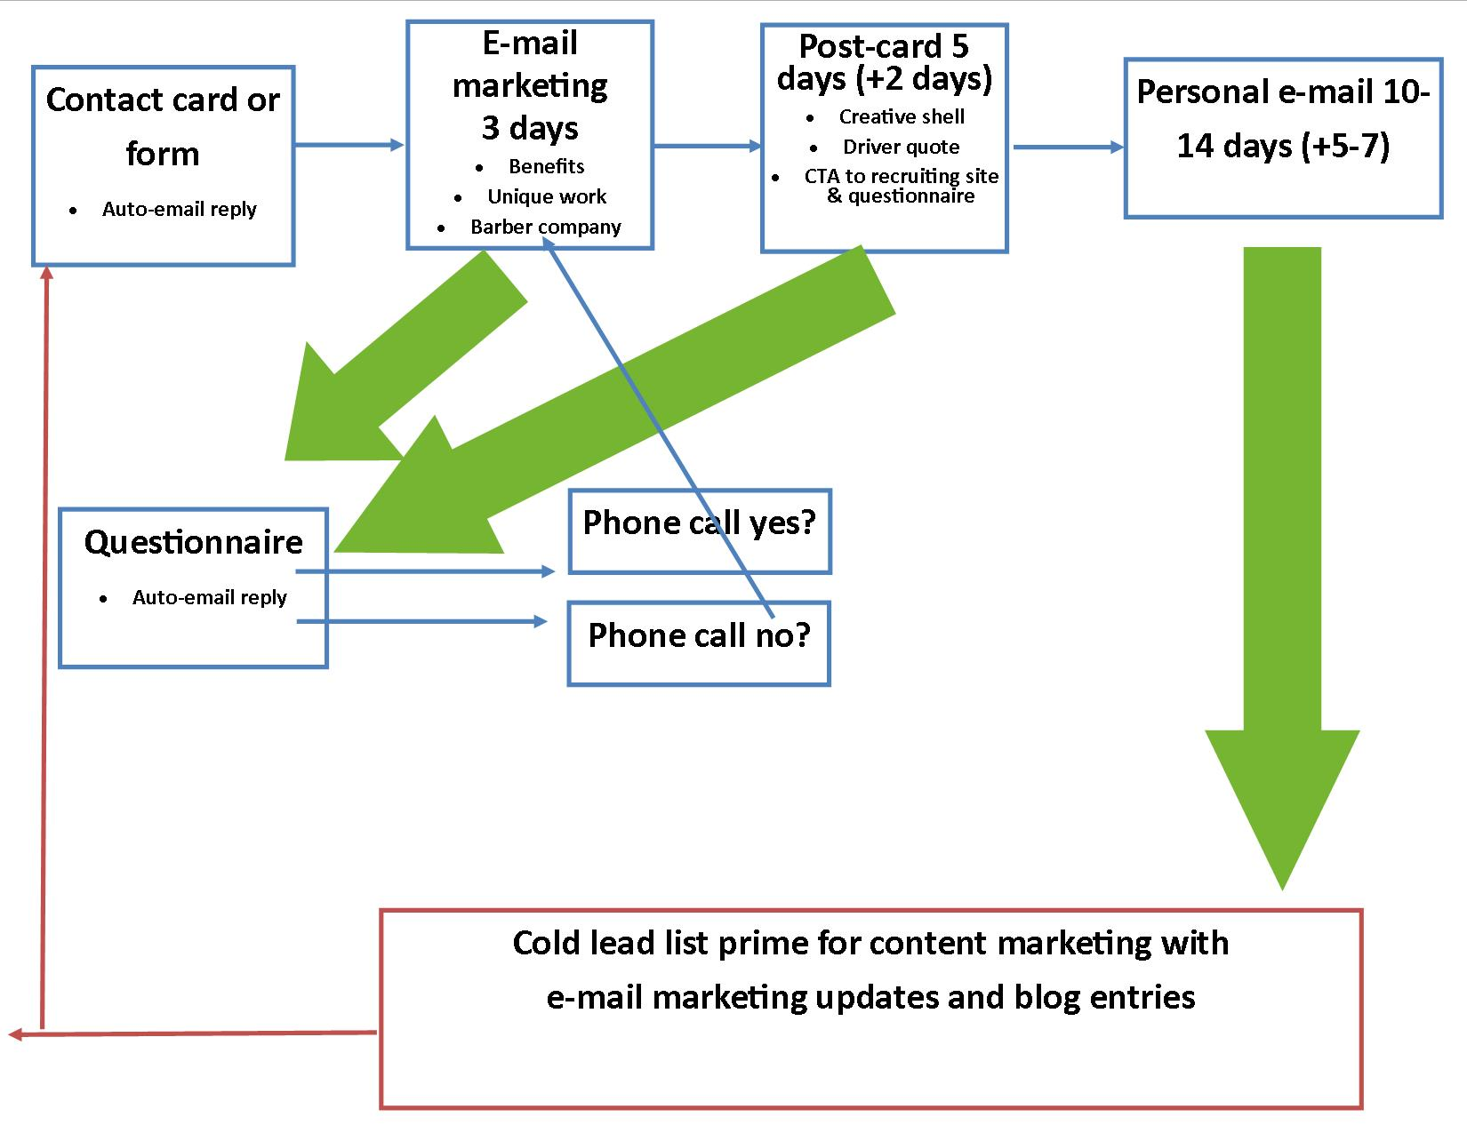
Drip marketing schedule

Slide 62
Direct targeting
Targeted direct mail list
Post-card directing them to microsite
Pushes to fill out Questionnaire, or next best thing is shorter Contact card
1000 CDL drivers in Northwestern PA
Also send to former Barber drivers
Unique Truck Driver Lists
Women Truck Drivers List
Hispanic Truck Drivers List
Truckers List Profile
Send us your CDL drivers, and we’ll generate a “Demographic Profile” … a powerful report to help identify your “ideal” trucker profile
This is how to target Owner-Operators quickly vs. outdoor advertising
Trucking / CDL America - Firms with Trucks / Fleets Mailing List

Slide 63
Personal Recruiting
Schools
Vo-Tech Schools
High Schools
Truck Driving Schools
CDL Schools
Transport Tech (Brookville, Meadville)
Future Truckers of America (Winston NC)
Truck Shows
Touch a Truck: DuBois and Clarion (September), and Jamestown NY
Clearfield County Big Rig Show: September

Slide 64
Info Session (open house)
For potential drivers
Saturday
All 3 locations or in more populated area, possibly in our targeted geography identified
recruiting event end of April for CDLs that respond to direct mailer and fill out contact form or questionnaire online, or any contact cards collected

Slide 65
Outreach event for Vo-tech
Invite Vo-tech students to Barber to learn about careers within a trucking company
CDL drivers
Dispatch
Operations
Management and administrative
Mechanic

Slide 66
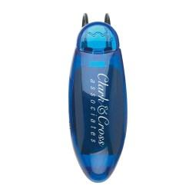
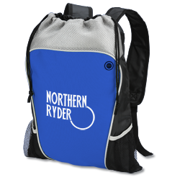
Promotional
Giveaway items
Sunglass holders
Sticky calendars
Draw-string tote
Zip up Hoodie
Uses
Current drivers can wear & use
Recruiting & community awareness events
(Hand-outs and as a door prize)
Distributed at truck stops and other locations
(Laundry rooms, game rooms, barber shops)

Slide 67
Lawn signs

Slide 68
Public Awareness

Slide 69
Community awareness
Summer Fairs
Sponsorships are usually a few hundred dollars
Community supporter
Don’t need to have a booth necessarily
Sponsor signage using creative shells and website
Community Sponsorships
Community support
Downtown/Main Street Initiatives
Need to milk the Publicity exposure that comes with it

Slide 70
Open Houses for Community
PA: Community/Business open house through Brookville and Punxsy chamber
NY & NC as well 2-3 months after we join chambers
Early event dinner 4-6p
Invites business and community influencers
Barber staff on-hand to meet and mingle
Driver materials available to spread awareness

Slide 71
Publicity
Stems from content marketing
Driver of the month / year
Feature driver
Military and veteran news stories and publicity
North Carolina story on Staff Sergeant Dan

Slide 72
Charities: Wounded Warrior
Donate monetarily
Buy merchandise as giveaways/appreciation gifts
Attend/sponsor local area events
A Taste of the Tri-County at Clearfield County Fairgrounds
Host annual Event
Start an annual fundraiser (truck related such as big rig pull)
Like Facebook Page & share appropriate posts

Slide 73
New CDLs Non-CDLs

Slide 74
Personal Recruiting new CDL
CDL schools
Relationships with career placement offices
Attend career fairs
Target new CDL drivers to hook and cultivate them into highly loyal Barber Truckers, not wanting to look elsewhere for .01cpm more

Slide 75
Non-CDLs
It’s important to have an outreach plan to get to kids in high school, vo-tech schools or younger adults in the general public to educate them on Barber Trucking and our selling points.

Slide 76
Retention

Slide 77
Retention: Make each employee feel like a valued member of the team, and they won’t want to go elsewhere!
During orientation/training
Make sure the instructor uses the new employees’ names
Give them each a tote with a name tag on it & their training materials inside
Let them know the “Chain of command” but give them a business card with their location manager’s information
Make sure a manager talks to them at their first week inspection
Get them involved and interaction on social media
Acknowledge milestone (personal & professional)
Birthdays
Anniversary with the company
Discuss their goals and future with the company

Slide 78
Retention
Addressing Away From Home
Better wifi connection in the trucks? Hot spot? Connection better to family with Facetime/video chat
Addressing Stress
Driver health and wellness
Contest with teams of 4 to do a weight loss challenge over 3 months

Slide 79
Retention
First 90-days
Gift card $50-60 for family to go to dinner
Magnus can negotiate deal with restaurant
Driver award
Consider adding Driver of the Quarter
Increases honor of the Driver awards by adding a middle tier
Tickets to a concert in Pittsburgh or BJC (State College), Penn State Football, Pitt Panther football or Pirates game, or Amusement park / Zoo tickets with restaurant gift card and gas
Two years with Barber
Thank you card from Joe.

Slide 80
Budget, timeline and measureables

Slide 81
Budget
Marketing
Memberships $1,200
Microsite (theme, security, domain, host) $475
Video production (1-2 video, :30) $7,000
Direct marketing
Direct mail cards $4,500
Events/outreach drivers $1,000
Promotional items $6,500
Advertising
Job trucking websites $2,000
TV: over 5 months in all 3 areas $20,000
Social media $1,000
Community/outreach
Fairs and sponsorships $3,000
Open house to business community $2,000
Retention $5,000
$53,675
$40,000-45,000

Slide 82
GANTT chart (timeline)
 | Mar | Apr | May | June | July | August | September
Content
Microsite
Contact card/questionaire
Video planning/scope of work
Video shoot and production
Blog content
Direct marketing
Content outline
Direct mailer to CDL holders
Personal recruiting at Vo-Techs and Truck Driving schools
Info session for drivers
Outreach event inviting students
Promotional items
Lawn signs
Advertising
Job & Trucking websites
Truck branding
Television
Social media advertising
Magazines (maybe start publicity first)
Public Awareness & Community
Memberships
Summer Fairs
Open House
Retention

Slide 83
Metrics
Cost per driver acquisition
Overall
Direct marketing + Media Advertising + Events & Outreach / total number of drivers hired
Per state
Direct marketing + Media Advertising + Events & Outreach / total inquiries (contacts & questionnaires)

Slide 84
Thank you for your time! Discussion.

